Slide 1

Code Analysis
Zhengong (才振功)
2011-07-27

Slide 2
Agenda
Software Analysis Overview
Methodology & Methods
Tools Demo
Project Candidates & Discussion

Slide 3
Software Analysis for What?
Scenario 1
  Company B buys another one C for market needs. C has a running system with a small maintenance group. B wants to expand the business of the related system. However, the system documents are outdated, and the original developers leave. Moreover, the platform of the system cannot get enough supports from the providers. On the other hands, developing a replacement system will bring great cost and risks, for the lack of comprehension of the system and its business logics……

Slide 4
Software Analysis for What?
Scenario 2
  Project A has been in progress for several months, a new developer D involves as a replacement since a original member leaves. D needs to knows of the source code, documents and other materials before starting the development….
Scenario 3
  A bug reported by QA or customer. As a developer, how to locate the bug and fix it in a given time? On the other hand, the customer hope to add a new function, where to add and which source code to be modified….

Slide 5
What’s Software Analysis
Definition
  Software analysis is a process or action to validate, verify or locate software features (or constraints) manually or automatically
Similar terms
  Program comprehension / reverse engineering
Scope
  Development phase：know of the progress, predict the developing actions, eliminate the defeats and program changes, etc
  Maintenance phase：program comprehension and software maintenance
  Reuse phase：analysis and reuse the available parts

Slide 6
The Goals
Program comprehension
  Functionality
  architecture
Feature Location
  locate the bug
  locate where to add new functions
Code Review
  Coding styles
  Program optimization
  In a word, identify the code architecture and map source code to abstract models

Slide 7
Objects for Analysis
Source Code – code analysis
Models
  Requirements
  Design Models
  Software Architecture
Documents, including requirements, design, test, etc.
Comments

Slide 8
Problems With Code Analysis
Compilation Environment
A
P
P
L
I
C
A
T
I
O
N
Source
Code
S
Y
S
T
E
M
Compile
Link
Syntactic Data
for Code
Analysis
Syntactic & Semantic Data for Code Analysis
1. Business domain vs application domain
2. Source code vs abstract business
3. Tools are costly
1. Physical actions vs logics
2. Structural program vs unstructured semantic data
Code Analysis Tool

Slide 9
Methodology and Methods
Static analysis
Dynamic analysis
Hybrid approaches

Slide 10
Static Analysis
Basic approaches
  Control flow analysis
  Data flow analysis
  Information flow analysis
  Symbolic execution
  Slice analysis
  Clone analysis
  Syntax analysis
  Type analysis

Slide 11
Static Analysis
  Range checking
  Structure analysis
  Alias analysis
  Pointer analysis
Formal approaches
  Model checking
  Theorem proving
  Not limited to these. More methods….

Slide 12
Control Flow Analysis
Goals：to construct CFG
  Analysis the execution path
  Abstract the code structure
  Locate dead code
  Evaluate the loops and recursion
Methods
  Sequence diagram
  Call graph
  Structure analysis
  Program slice

Slide 13
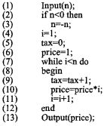
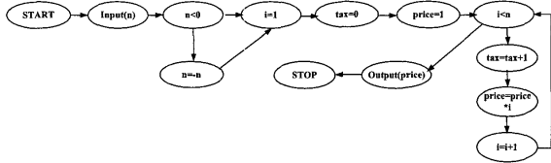
Control Flow Analysis
Example

Slide 14
Data Flow Analysis
Goals：evaluate the definition and use of variable in each statement
  Variable definition
  Input should not be re-assigned
  Output should be assigned
  Proper global variable
DFA：usually starts with CFA
  forward analysis——reaching definition
  backward analysis——live variables，eliminating dead code

Slide 15
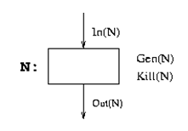
Classical Data-flow Problems
Reaching definitions (Reach)
Live uses of variables (Live)
Def-use chains built from Reach, and the dual Use-def chains, built from Live, play role in many optimizations
Set of variables
  Gen(N) = set of variables defined by Node N.
  Kill(N) = set of variables killed by Node N .
  IN(N)=set of variables from the previous nodes
  Forward order: Out(N) = Gen(N) +(In(N) - Kill(N));

Slide 16
Reaching Definitions
Definition A statement that may change the value of a variable (e.g., x = i+5)
A definition of a variable x at node k reaches node n if there is a path clear of a definition of x from k to n.
k
x = …
x = …
n
… = x

Slide 17
Live Uses of Variables
Use Appearance of a variable as an operand of a 3-address statement (e.g., y=x+4)
A use of a variable x at node n is live on exit from k if there is a path from k to n clear of definition of x.
k
x = …
x = …
n
… = x

Slide 18
Def-use Relations
Use-def chain links an use to a definition that reaches that use
Def-use chain links a definition to an use that it reaches
k
x = …
x = …
n
… = x

Slide 19
Optimizations Enabled
Dead code elimination (Def-use)
Loop invariant code motion (Use-def)
Constant propagation (Use-def)
Strength reduction (Use-def)
Copy propagation (Def-use)
Notes:
Dead code – defined but not used
Loop invariant code motion – statements in loop only depends on the variables outside of loop can be moved out.
Constant propagation – variable with only one constant value can be replaced by the constant
Strength reduction – multiple replaced by add and expo by multiple in loop;
Copy propagation – if all the use of a definition may be safely modified, the definition can be removed

Slide 20

Information Flow Analysis
Goals：
  The dependency tracing from output to input
  Validate the dependency according to initial constraints
IFA methods：
  Intra-procedural analysis
  Inter-procedural analysis
Example:
X := A + B;
Y := D – C;
if X>0 then
Z := Y + 1;
end if;
Here:
X depends on A & B
Y depends on C & D
Z depends on A, B, C, & D
and implicitly on Z’s initial value

Slide 21
Symbolic Execution
Goals
  Verify properties of a program by algebraic manipulation of the source text without requiring a formal specification
Methods:
  Typically performed where the program is “executed” statically by performing back-substitution
  Converts sequential logic into a set of parallel assignments in which output values are expressed in terms of input values
A + B <= 0:
      X = A + B
      Y = D – C
      Z = not defined
    A + B > 0:
      X = A + B
      Y = D – C
      Z = D – C + 1
Previous Example:
X := A + B;
Y := D – C;
if X>0 then
Z := Y + 1;
end if;

Slide 22
Slicing Analysis
Goals
  Extract the source code related to the concern，i.e. slice
Method：
  Obtain the concern-related variable
  Analyze the related statements and predicate，to form a slice
  Analyze the slice to comprehend the program
Analysis approach
  Data flow analysis
  Dependency analysis

Slide 23
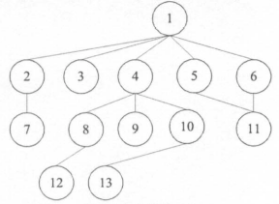
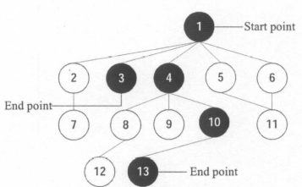
Slicing Analysis
Example

Slide 24
Backward Slice
int main() {
int sum = 0;
int i = 1;
while (i < 11) {
sum = sum + i;
i = i + 1;
}
printf(“%d\n”,sum);
printf(“%d\n”,i);
}
Backward slice with respect to “printf(“%d\n”,i)”

Slide 25
Backward Slice
int main() {
int sum = 0;
int i = 1;
while (i < 11) {
sum = sum + i;
i = i + 1;
}
printf(“%d\n”,sum);
printf(“%d\n”,i);
}
Backward slice with respect to “printf(“%d\n”,i)”

Slide 26
Slice Extraction
int main() {
int i = 1;
while (i < 11) {
i = i + 1;
}
printf(“%d\n”,i);
}
Backward slice with respect to “printf(“%d\n”,i)”

Slide 27
Forward Slice
int main() {
int sum = 0;
int i = 1;
while (i < 11) {
sum = sum + i;
i = i + 1;
}
printf(“%d\n”,sum);
printf(“%d\n”,i);
}
Forward slice with respect to “sum = 0”

Slide 28
Forward Slice
int main() {
int sum = 0;
int i = 1;
while (i < 11) {
sum = sum + i;
i = i + 1;
}
printf(“%d\n”,sum);
printf(“%d\n”,i);
}
Forward slice with respect to “sum = 0”

Slide 29
Control Flow Graph
int main() {
int sum = 0;
int i = 1;
while (i < 11) {
sum = sum + i;
i = i + 1;
}
printf(“%d\n”,sum);
printf(“%d\n”,i);
}
Enter
F
sum = 0
i = 1
while(i < 11)
printf(sum)
printf(i)
T
sum = sum + i
i = i + i

Slide 30
Flow Dependence Graph
int main() {
int sum = 0;
int i = 1;
while (i < 11) {
sum = sum + i;
i = i + 1;
}
printf(“%d\n”,sum);
printf(“%d\n”,i);
}
Flow dependence
p
q
Value of variable
assigned at p may be
used at q.
Enter
sum = 0
i = 1
while(i < 11)
printf(sum)
printf(i)
sum = sum + i
i = i + i

Slide 31
Control Dependence Graph
int main() {
int sum = 0;
int i = 1;
while (i < 11) {
sum = sum + i;
i = i + 1;
}
printf(“%d\n”,sum);
printf(“%d\n”,i);
}
Control dependence
p
q
q is reached from p
if condition p is
true (T), not otherwise.
T
p
q
Similar for false (F).
F
Enter
T
T
T
T
T
T
sum = 0
i = 1
while(i < 11)
printf(sum)
printf(i)
T
T
sum = sum + i
i = i + 1

Slide 32
Program Dependence Graph (PDG)
int main() {
int sum = 0;
int i = 1;
while (i < 11) {
sum = sum + i;
i = i + 1;
}
printf(“%d\n”,sum);
printf(“%d\n”,i);
}
Control dependence
Flow dependence
Enter
T
T
T
T
T
T
sum = 0
i = 1
while(i < 11)
printf(sum)
printf(i)
T
T
sum = sum + i
i = i + 1

Slide 33
Program Dependence Graph (PDG)
int main() {
int i = 1;
int sum = 0;
while (i < 11) {
sum = sum + i;
i = i + 1;
}
printf(“%d\n”,sum);
printf(“%d\n”,i);
}
Opposite Order
Same PDG
Enter
T
T
T
T
T
T
sum = 0
i = 1
while(i < 11)
printf(sum)
printf(i)
T
T
sum = sum + i
i = i + 1

Slide 34
Backward Slice
int main() {
int sum = 0;
int i = 1;
while (i < 11) {
sum = sum + i;
i = i + 1;
}
printf(“%d\n”,sum);
printf(“%d\n”,i);
}
Enter
T
T
T
T
T
T
sum = 0
i = 1
while(i < 11)
printf(sum)
printf(i)
T
T
sum = sum + i
i = i + 1

Slide 35
Backward Slice (2)
int main() {
int sum = 0;
int i = 1;
while (i < 11) {
sum = sum + i;
i = i + 1;
}
printf(“%d\n”,sum);
printf(“%d\n”,i);
}
Enter
T
T
T
T
T
T
sum = 0
i = 1
while(i < 11)
printf(sum)
printf(i)
T
T
sum = sum + i
i = i + 1

Slide 36
Backward Slice (3)
int main() {
int sum = 0;
int i = 1;
while (i < 11) {
sum = sum + i;
i = i + 1;
}
printf(“%d\n”,sum);
printf(“%d\n”,i);
}
Enter
T
T
T
T
T
T
sum = 0
i = 1
while(i < 11)
printf(sum)
printf(i)
T
T
sum = sum + i
i = i + 1

Slide 37
Backward Slice (4)
int main() {
int sum = 0;
int i = 1;
while (i < 11) {
sum = sum + i;
i = i + 1;
}
printf(“%d\n”,sum);
printf(“%d\n”,i);
}
Enter
T
T
T
T
T
T
sum = 0
i = 1
while(i < 11)
printf(sum)
printf(i)
T
T
sum = sum + i
i = i + 1

Slide 38
Slice Extraction
int main() {
int i = 1;
while (i < 11) {
i = i + 1;
}
printf(“%d\n”,i);
}
Enter
T
T
T
T
i = 1
while(i < 11)
printf(i)
T
i = i + 1

Slide 39
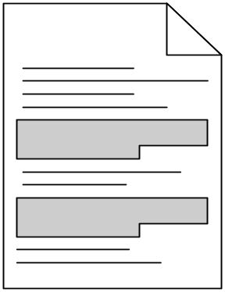
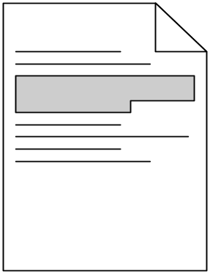
Clone Analysis
Code clone is a code fragment in source files that is identical or similar to another
Clone Pair
Clone Class
Code clone is one of factors that make software maintenance more difficult.
  If some faults are found in a code clone, it is necessary to consider pros and cons of modification in its all code clones.

Slide 40
Clone Analysis
Improvements for clone code
  Extract method
  Pull up method
Tools
  CCFinder
  Gemini

Slide 41
Extract Method
void methodA(int i){
methodZ();
System.out.println(“name:” + name);
System.out.println(“amount:” + i);
}
void methodB(int i){
methodY();
System.out.println(“name:” + name);
System.out.println(“amount:” + i);
}
void methodA(int i){
methodZ();
methodC(i);
}
void methodB(int i){
methodY();
methodC(i);
}
Void methodC(int i){
System.out.println(“name:” + name);
System.out.println(“amount:” + i);
}
methodC(i);
methodC(i);
Notes:
Next, I briefly explain the two refactoring techniques, extract method and pull up method.
Firstly, I explain extract method.
For example, this source code defines two methods, A and B.
Each method includes these two statements.
By extracting them as one method, this source code is modified like this.
In this example, these two System.out.printlns are re-defined as a new method, C.

Slide 42
Pull Up Method
class A
class A
method A
class B
class C
class B
class C
method A
method A
Notes:
Secondly, I explain pull up method.
This means that same methods which are defined in several children classes are pulled up to common parent class.
In this example, method A defined in class B and class C are pulled up to class A.

Slide 43
Syntax Analysis
Goals
  Construct AST (Abstract-Syntax Tree)
  Validate the AST according to BNF
Methods
  Bottom-up：operator first methods
  Top-down：recursive approach
  Context-free, like Left-Right, etc
  Syntax analysis is also the fundamental of compiling and other analysis approaches.

Slide 44
Type Analysis
Goals
  Locating the type errors
Methods
  Most are based on static analysis, for eliminating the type errors and verifying the software quality
  Some based on dynamic analysis

Slide 45
Pointer Analysis
Goals
  Find locations to which a pointer may point to
  Lies at the heart of many program optimization and verification problems
Pointer analysis is un-decidable in static analysis
  There exist many conservative approximations
  Small points-to set ➔ more precision
Factors
  Flow sensitivity
  Context sensitivity
  Etc.

Slide 46
Alias Analysis
Why?
  More accurate memory dependence analysis and data flow analysis.
  More aggressive optimization and scheduling. Without alias analysis, data flow analysis, optimization and scheduling have to be conservative.
Example
  r 1= arr[1];
  arr[2]=r2;
  r3=arr[1];
  val=r3+arr[3];

Slide 47
Alias Analysis
Challenges
  Formal parameters
  Function pointers
  Struct & union
  Type-casted
Alias Analysis: Computes pairs of pointers that may point to the same memory location
  Used primarily by older pointer analysis for C
  Can be computed using a points-to analysis
    may-alias(v₁,v₂) if points-to(v₁) ∩ points-to(v₂) ≠ Ø

Slide 48
Alias Analysis
Example
  Class Quad{
  uint32 ulow;
  uint32 uhigh;
  };
  Class qpart {
  ushort c, d, a, b;
  }
  Quad quad;
  qpart s = & quad;
c
d
ulow
a
b
uhigh

Slide 49
Range Checking
Goals:
  Ensure data values lie within the specified ranges
  Ensure data maintains specified accuracy
Methods:
  Overflow and Underflow Analysis
  Range Checking Analysis
  Array Bounds Checking
  Rounding Errors Analysis
Discrete static bounds can often be checked automatically
Checking is straight forward for Enumeration Types
Absence of overflow for Real Types can be demanding

Slide 50
Structure Analysis
Goals
  How artifacts build into higher level artifacts
  How artifacts depend on each other
  visualization
methods：
  Dependency analysis
  Impact analysis
Tools
  STAN – a structure analysis tool for Java
  IBM Rational Rose
  MS Visio

Slide 51
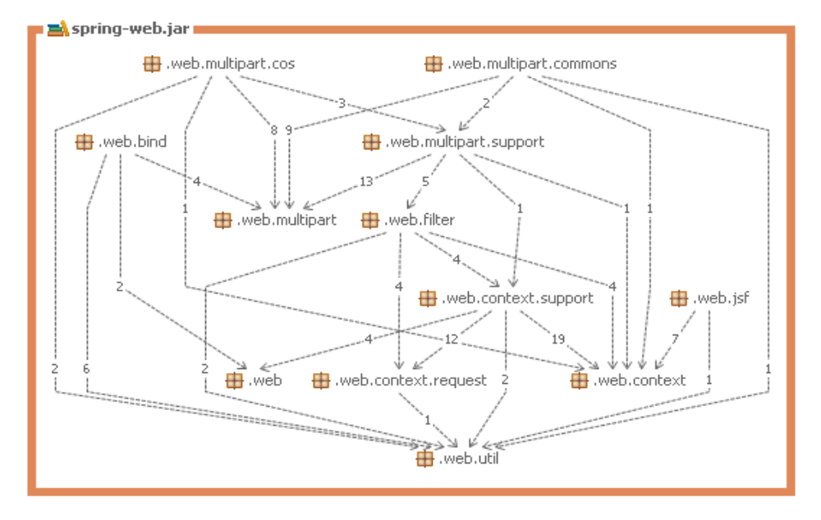
Structure Analysis
Directed dependency graph

Slide 52
Model Checking
Goals
  Verifying the system models according to requirements
Methods
  State transition
  Modal / temporal logics
  Define and validate the mathematical problem “can state transition satisfy the logics ”
Potential problems——models abstraction from code may lose some information
Tools——SLAM，Java PathFinder2, etc.

Slide 53
Theorem Proving
Objects
  Theoretical proof of the system logics
Features
  Based on formal or mathematical approach
  Most complex and precise
  Relies on the manual transition and configuration
Tools——ESC，ESC/Java

Slide 54
Pros and Cons of Static Analysis
Pros
  Can cover all the code and paths
  Prior knowledge is not mandatory, applicable for unfamiliar code
  For complete comprehension and partial comprehension
Cons
  The precision is affected by dynamic features
  Relies on programming languages and coding styles
  Some data dependencies are too complicated

Slide 55
Dynamic Analysis
Dynamic tracing
Off-line validation
Online detecting

Slide 56
Dynamic Tracing
Output-based
  Use the system output, log, etc.
Code instrumentation
  Source code instrumentation
  Binary code instrumentation
  Interceptor for the communication between caller and callee
By interfaces of platform
  Use the development platform, like OS, JVM, etc.

Slide 57
Off-line validation
Input generation
  First static analysis
  Goal-driven input generation
Constraint description
  Describe the constraints using the linear sequence diagram
Execution trace analysis
  Plenty of internal and output data at runtime
  Trace generation from these data
  Verify the trace against the constraints

Slide 58
Online Detecting
In-line
  The monitor runs in the space with the system
  High efficiency, quick response
  May affect the system itself
Out line
  Monitor runs in independent space
  Can deal with multiple outputs
  Low efficiency

Slide 59
Online Detecting
Features
  The input should not affect the normal execution of the system
  The monitor is always part of the system

Slide 60
Pros and cons
Pros
  The running results are more trustable
  Incremental comprehension by adding test cases
  High precision
Cons
  Prior knowledge is inevitable to design test cases
  Test cases are often not thorough
  Can not filter dead code
  Require ability to run program

Slide 61
Hybrid Analysis
Dynamic Analysis (DA) + Information Retrieval (IR)
DA + Impact Analysis
DA + Web Mining
DA + IR + dependency analysis
IR + BRCG
Analysis + Test
etc.

Slide 62
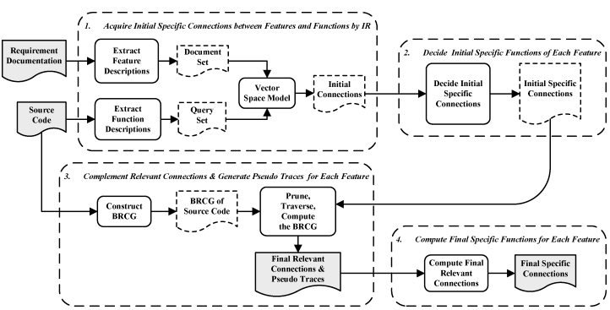
IR+BRCG
Approach overview

Slide 63
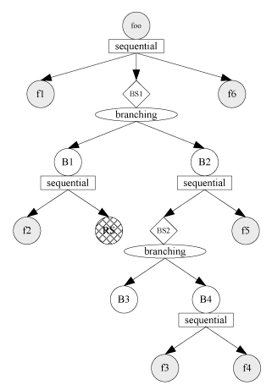
IR+BRCG
A BRCG example

Slide 64
Tool Demo
Instrumentation
  Bytecode instrumentation – IBM BIPTK
Information Retrieval
  Lucene 3.0
Static analysis
  PMD
  Architexa @ http://www.architexa.com/
  Code Analysis Plugin @ http://sourceforge.net/projects/cap4e/
  AppPerfect @ http://www.appperfect.com/download/files/index.html

Slide 65
Projects
Projects candidates
  JDK
  Junit
  Log4j
  Struts 2.0
  Spring
  Hibernate
Deliverables
  Analysis report, including at least architecture, flow chart or sequence diagram and function description

Slide 66
Thank You !

